Slide 1
症狀諮詢及商品推薦 對話系統
Advisor: J.-F. Wang
Student: 林毓善
Department of Electrical Engineering
National Cheng Kung University
Tainan, Taiwan, R. O. C.

Slide 2
Outline
Introduction
Flow chart
Database-collection and arrangement
Pre-Processing
Jieba
Slot-filling and Word-Embedding

Slide 3
Outline
Intent Detection
Cosine similarity
Intent Reasoning
Dialogue Manager
Diagnostic Reasoning
Linking to Database
Natural Language Generation
Conclusion

Slide 4
Introduction
症狀諮詢及商品推薦對話系統
症狀諮詢
商品推薦
先取得一些症狀，再以問答方式完成整個診斷過程
診斷完後回傳給使用者商品做選擇

Slide 5
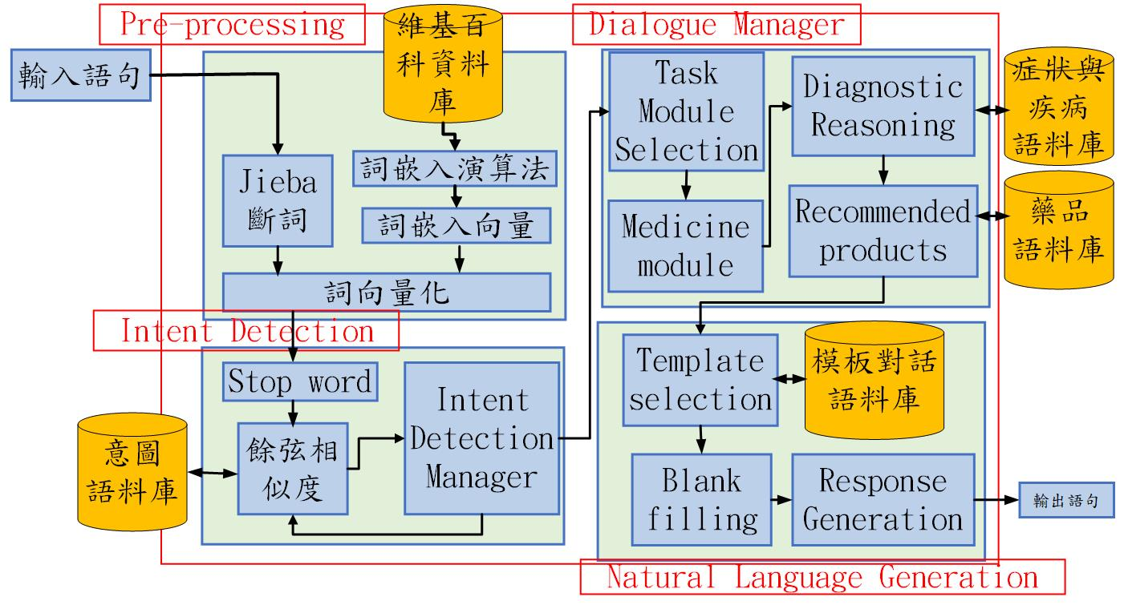
Flow Chart

Slide 6
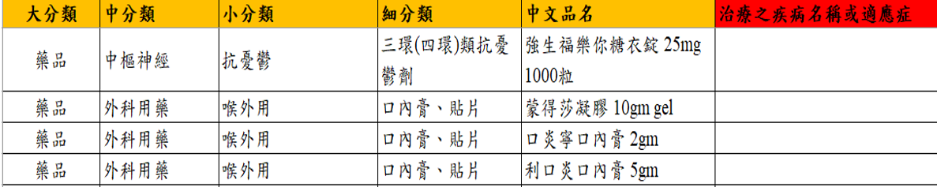
Collect Database
藥局商品資料庫
由藥局方提供
擁有2000筆藥局裡所販售之藥品及保健食品
尚缺乏藥品對應到之疾病與症狀

Slide 7
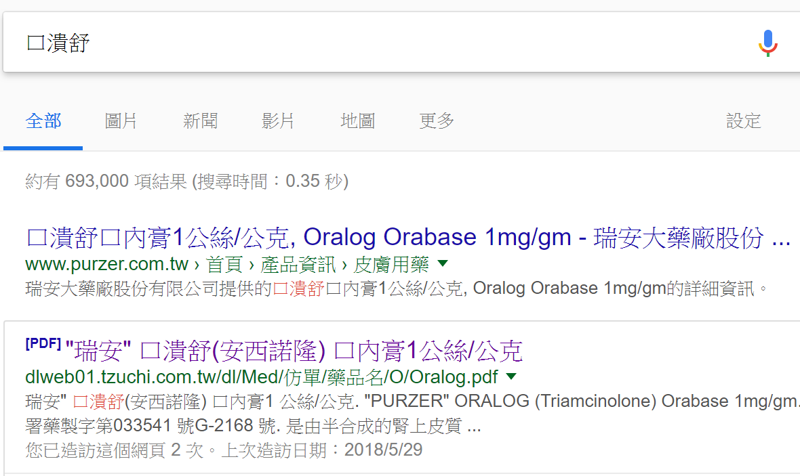
Collect Database
從藥局資料庫出發-搜尋相對應之疾病
先在Google上搜尋藥品名稱
查到藥品之治療用途、適應症

Slide 8
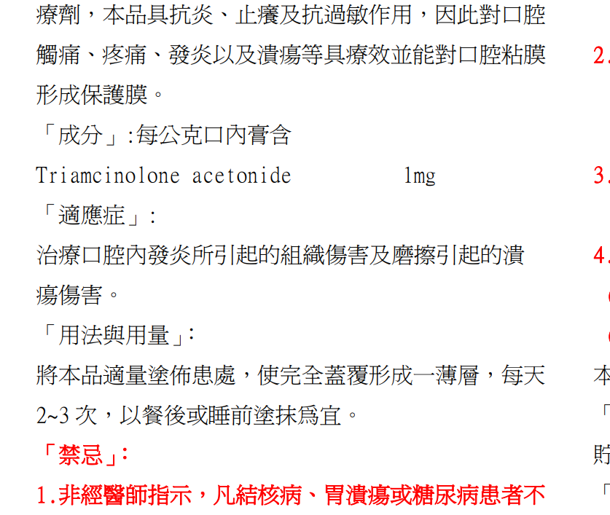
Collect Database

Slide 9
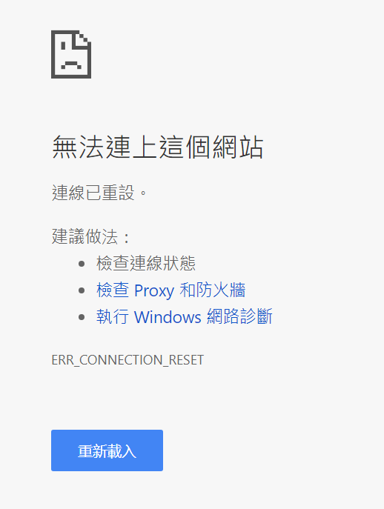
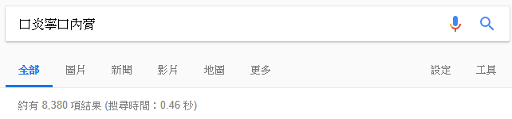
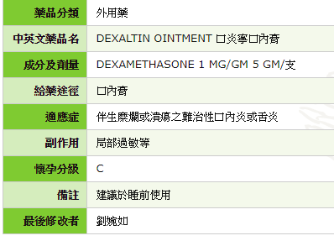
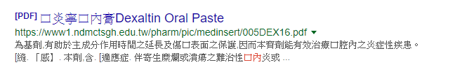
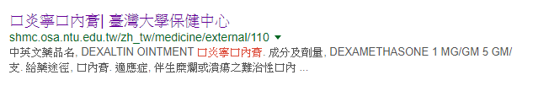
Collect Database
從藥局資料庫出發-搜尋相對應之疾病
先在Google上搜尋藥品名稱
查到藥品之治療用途、適應症
口炎寧口內膏

Slide 10
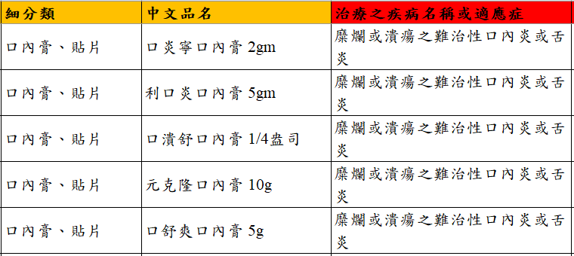
Collect Database
從藥局資料庫出發-搜尋相對應之疾病
蒐集到治療用途、適應症
將蒐集到之治療用途與適應症再去Google找出其症狀

Slide 11
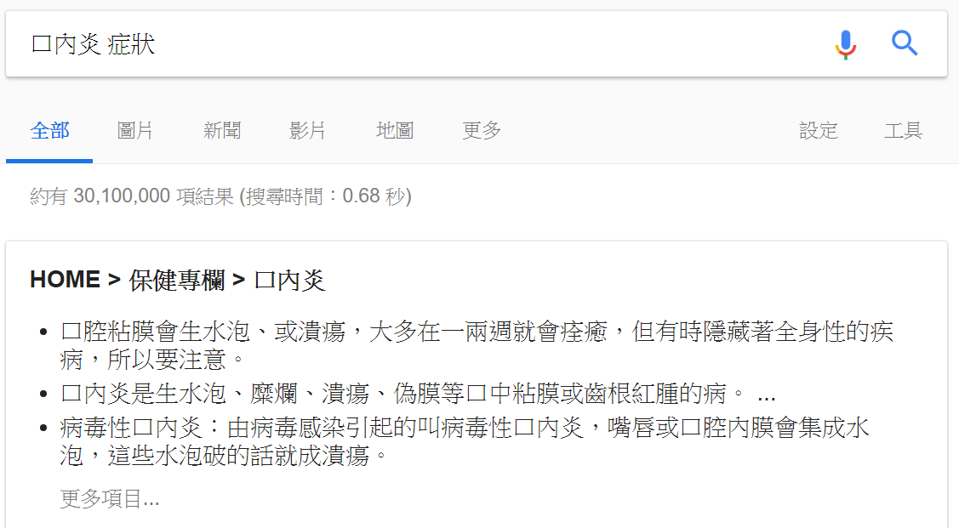
Collect Database
從藥局資料庫出發-搜尋相對應之疾病
將蒐集到之治療用途與適應症再去Google找出其症狀
口內炎 症狀

Slide 12
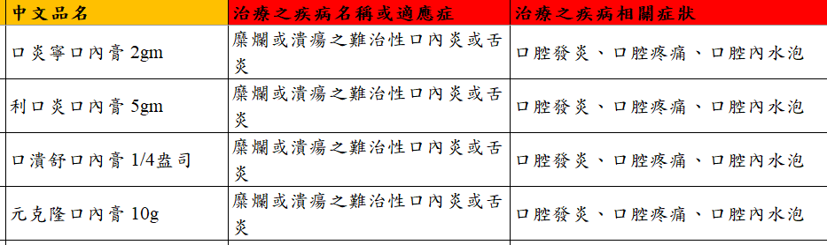
Collect Database
從藥局資料庫出發-搜尋相對應之疾病
將蒐集到症狀填入資料庫裡

Slide 13
Flow Chart

Slide 14
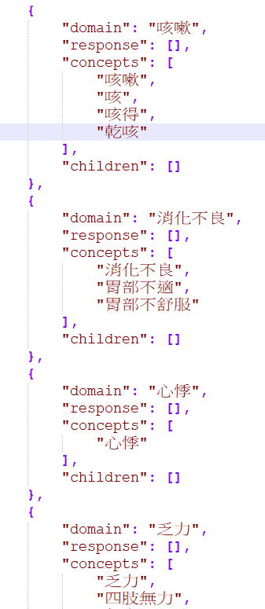
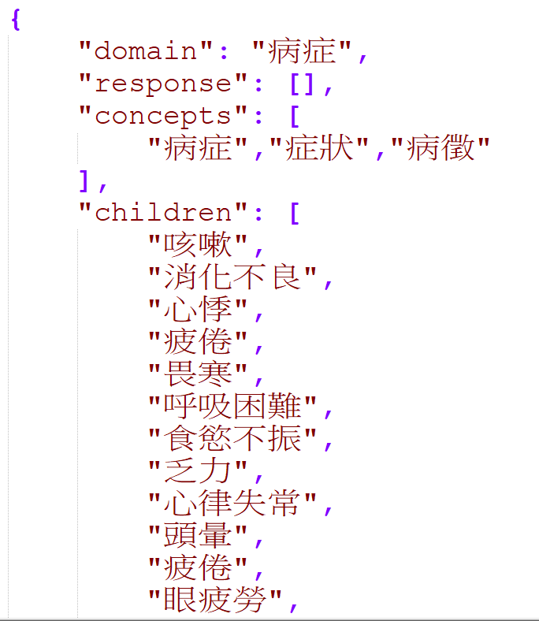
Collect Database
意圖資料庫
整理病症，因為以症狀為系統
主要詢問的意圖，所以整理方向以症狀為主體
總共70項症狀對應至50種常見之疾病

Slide 15
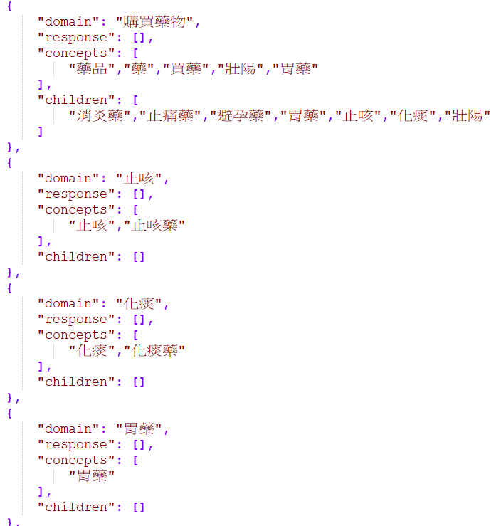
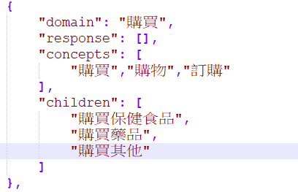
Collect Database
意圖資料庫
整理商品，整理方向以商品
為主體
總共約25項商品意圖

Slide 16
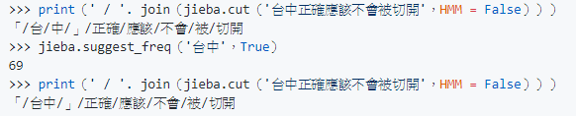
一、Pre-Processing - Jieba
Jieba斷詞
近年最常用之斷詞系統
與CKIP相較之下使用方便
Python有支援，不像CKIP使用上需連線
容易新增新詞彙
https://github.com/fxsjy/jieba

Slide 17


一、Pre-Processing – Word Embedding and Slot Filling
Word Embedding
運用大量之文章訓練而得的詞向量
可用於比對以建好之意圖(intent)是否在句子當中
類似的詞之詞向量會非常相近。例如:嘔吐，噁心等
http://zake7749.github.io/2016/08/28/word2vec-with-gensim/

Slide 18
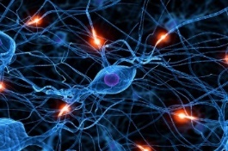

Word Embedding
Machine learns the meaning of words from reading a lot of documents without supervision
Word Embedding
tree
flower
dog
rabbit
run
jump
cat

Slide 19
1-of-N Encoding
Word Embedding
apple = [ 1 0 0 0 0]
dog
bag = [ 0 1 0 0 0]
rabbit
run
cat = [ 0 0 1 0 0]
jump
cat
dog = [ 0 0 0 1 0]
tree
flower
elephant = [ 0 0 0 0 1]
Word Class
class 1
Class 2
Class 3
dog
ran
flower
cat
jumped
bird
walk
tree
apple

Slide 20
Word Embedding
Machine learns the meaning of words from reading a lot of documents without supervision
A word can be understood by its context
You shall know a word by the company it keeps
蔡英文、馬英九 are something very similar
馬英九 520宣誓就職
蔡英文 520宣誓就職

Slide 21
Prediction-based – Training
潮水
Neural
Network
Collect data:
就
潮水 退了 就 知道 誰 …
不爽 不要 買 …
公道價 八萬 一 …
………
退了
退了
Neural
Network
知道
就
就
Neural
Network
Minimizing cross entropy
誰
知道
Notes:
What can it do? Application?

Slide 22
Prediction-based
w_{i}
…… w_{i-2} w_{i-1} ___
0
z₁
1-of-N encoding
of the word w_{i-1}
1
z₂
The probability for each word as the next word w_{i}
0
……
……
…
……
Take out the input of the neurons in the first layer
z₂
tree
flower
Use it to represent a word w
dog
rabbit
run
jump
cat
Word vector, word embedding feature: V(w)
z₁
Notes:
Note that we only consider one input word, we only consider wi-1
We will consider multiple word
The structured is a little different

Slide 23
Prediction-based
You shall know a word by the company it keeps
0
z₁
1
z₂
The probability for each word as the next word w_{i}
0
……
……
蔡英文
or
馬英九
…
……
“宣誓就職” should have large probability
Training text:
z₂
…… 蔡英文 宣誓就職 ……
蔡英文
w_{i-1}
w_{i}
馬英九
…… 馬英九 宣誓就職 ……
w_{i-1}
w_{i}
z₁
Notes:
A man is known by the company he keeps.
觀其友知其人
Why the word vectors can probably capture the meaning of the words

Slide 24
Prediction-based – Sharing Parameters
0
z₁
1-of-N encoding
of the word w_{i-2}
1
W₁
z₂
The probability for each word as the next word w_{i}
0
……
……
…
z
x_{i-2}
0
The length of x_{i-1} and x_{i-2} are both |V|.
1-of-N encoding
of the word w_{i-1}
W₂
The length of z is |Z|.
1
……
z = W₁ x_{i-2} + W₂ x_{i-1}
0
The weight matrix W₁ and W₂ are both |Z|X|V| matrices.
x_{i-1}
z = W ( x_{i-2} + x_{i-1} )
W₁ = W₂
= W
Notes:
Should I describe it more clearly?
Can consider longer history

Slide 25
Prediction-based– Various Architectures
Continuous bag of word (CBOW) model
Skip-gram
w_{i-1}
Neural
Network
…… w_{i-1} ____ w_{i+1} ……
w_{i}
w_{i+1}
predicting the word given its context
…… ____ w_{i} ____ ……
Neural
Network
w_{i-1}
w_{i}
w_{i+1}
predicting the context given a word

Slide 26
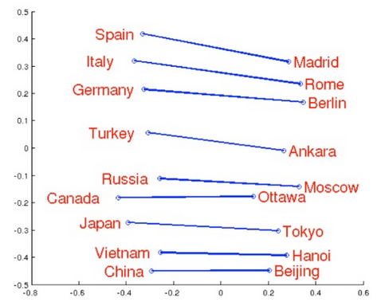
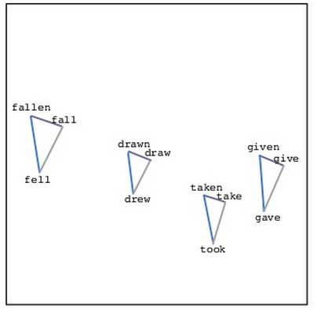
Word Embedding
Source: http://www.slideshare.net/hustwj/cikm-keynotenov2014
Notes:
Why can it happen
How to explain it

Slide 27
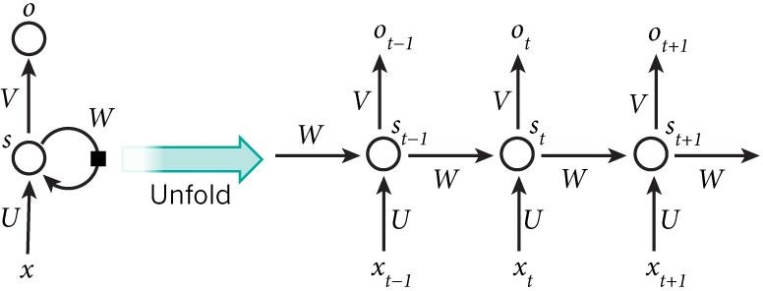
一、Pre-Processing – Slot Filling based on RNN
Material: http://deepdialogue.miulab.tw
time
RNN can learn accumulated sequential information (time-series)
http://www.wildml.com/2015/09/recurrent-neural-networks-tutorial-part-1-introduction-to-rnns/

Slide 28

Slot Filling
I would like to arrive Taipei on November 2nd.
ticket booking system
Destination:
Taipei
Slot
time of arrival:
November 2nd
Notes:
https://catalog.ldc.upenn.edu/docs/LDC93S4B/corpus.html

Slide 29
Slot Filling
Solving slot filling by Feedforward network?
Input: a word
(Each word is represented as a vector)
Taipei

Slide 30
Slot Filling
time of departure
dest
Solving slot filling by Feedforward network?
Input: a word
(Each word is represented as a vector)
Output:
Probability distribution that the input word belonging to the slots
Taipei

Slide 31
Slot Filling
time of departure
dest
arrive Taipei on November 2nd
other
dest
other
time
time
Problem?
leave Taipei on November 2nd
place of departure
Neural network needs memory!
Taipei

Slide 32
Recurrent Neural Network (RNN)
The output of hidden layer are stored in the memory.
store
Memory can be considered as another input.

Slide 33





Example
Input sequence:
$$\left[\begin{aligned}1 \\ 1\end{aligned}\right]$$
$$\left[\begin{aligned}1 \\ 1\end{aligned}\right]$$
$$\left[\begin{aligned}2 \\ 2\end{aligned}\right]$$
$$……$$
$$\left[\begin{aligned}4 \\ 4\end{aligned}\right]$$
output sequence:
4
4
store
2
2
given Initial values
0
0
All the weights are “1”, no bias
1
1
All activation functions are linear

Slide 34

Example
Input sequence:
$$\left[\begin{aligned}1 \\ 1\end{aligned}\right]$$
$$\left[\begin{aligned}1 \\ 1\end{aligned}\right]$$
$$\left[\begin{aligned}2 \\ 2\end{aligned}\right]$$
$$……$$
$$\left[\begin{aligned}4 \\ 4\end{aligned}\right]$$
$$\left[\begin{aligned}12 \\ 12\end{aligned}\right]$$
output sequence:
12
12
store
6
6
2
2
All the weights are “1”, no bias
1
1
All activation functions are linear

Slide 35

Input sequence:
$$\left[\begin{aligned}1 \\ 1\end{aligned}\right]$$
$$\left[\begin{aligned}1 \\ 1\end{aligned}\right]$$
$$\left[\begin{aligned}2 \\ 2\end{aligned}\right]$$
$$……$$
$$\left[\begin{aligned}4 \\ 4\end{aligned}\right]$$
$$\left[\begin{aligned}32 \\ 32\end{aligned}\right]$$
Example
output sequence:
$$\left[\begin{aligned}12 \\ 12\end{aligned}\right]$$
Changing the sequence order will change the output.
32
32
store
16
16
6
6
All the weights are “1”, no bias
2
2
All activation functions are linear

Slide 36
RNN
The same network is used again and again.
Probability of “arrive” in each slot
Probability of “Taipei” in each slot
Probability of “on” in each slot
y¹
y²
y³
store
store
a¹
a²
a³
a¹
a²
x¹
x²
x³
arrive Taipei on November 2nd
Notes:
General idea

Slide 37
RNN
Different
Prob of “leave” in each slot
Prob of “Taipei” in each slot
Prob of “arrive” in each slot
Prob of “Taipei” in each slot
y²
……
y²
……
y¹
y¹
store
store
a¹
a²
a¹
a²
a¹
……
a¹
……
x¹
x²
……
x¹
x²
……
leave
Taipei
arrive
Taipei
The values stored in the memory is different.
Notes:
Output y^{i} depends on x¹, x², …… x^{i}
The same input can have totoally different output.

Slide 38

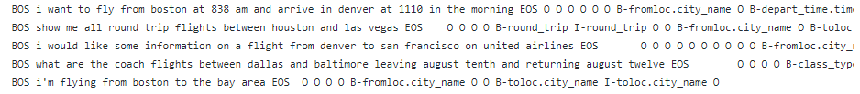
一、Pre-Processing –Drawback of Slot -Filling based on RNN
Slot Filling
需要大量的以標記之訓練資料(IOB tagging)
B-{CHUNK_TYPE} – for the word in the Beginning chunk
I-{CHUNK_TYPE} – for words Inside the chunk
O – Outside any chunk
https://github.com/chsasank/ATIS.keras

Slide 39
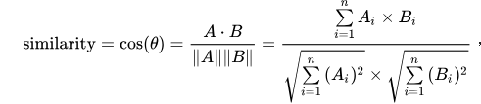
二、Intent Detection
Stop Word
將較不重要的詞去除，以增加準確度 例如:喔、了、那等詞
Cosine similarity
用於比對意圖與句子當中的詞之相似度
Slot-Filling using word-Embedding
類似之詞會有相似之向量，由此可以從句子抓出以建立之意圖

Slide 40
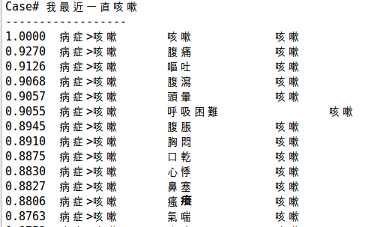
二、Intent Detection
Slot-Filling using word-Embedding

Slide 41
二、Intent Detection –Cosine similarity
Cosine similarity
用於比對意圖與句子當中的詞之
相似度
與已建好之意圖資料庫比對
先從最外層之意圖做比對，如有子項目，再往子項目做比對

Slide 42
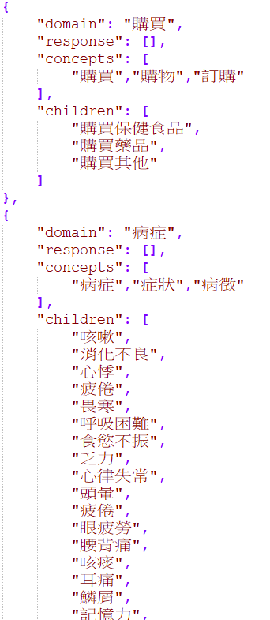
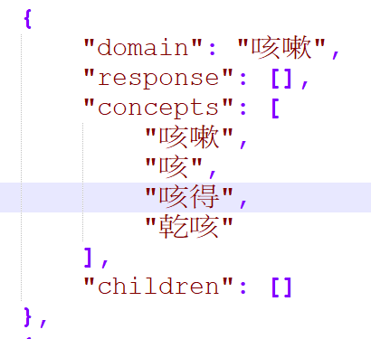
二、Intent Detection –Cosine similarity
與已建好之意圖資料庫比對
先從最外層之意圖做比對

Slide 43
二、Intent Detection – Intent Reasoning
Intent Reasoning
只使用上述之方法只能處理單詞
如果腰痛、頭痛之類的症狀，使用者將詞分開講，則會出錯
Ex.我的腰非常的痛。
如使用者輸入為:我的頭今天很痛，抓到的意圖會是“頭部“+”疼痛“，則推理成頭痛

Slide 44
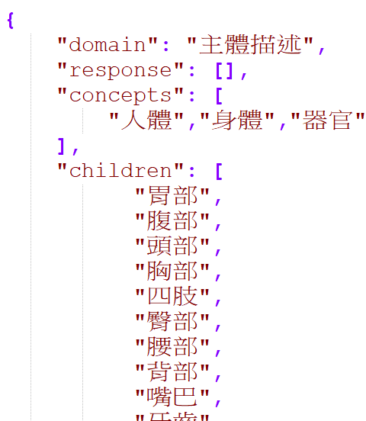
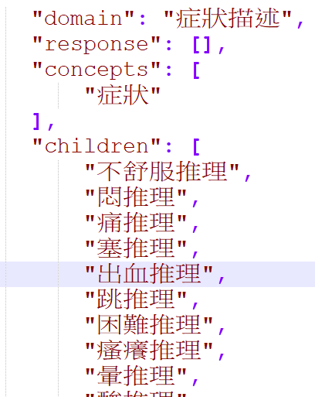
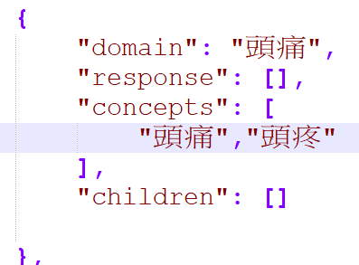
二、Intent Detection – Intent Reasoning

Slide 45
三、Dialogue Manager
Task Module Selection
選擇要完成之任務的模組，目前只有關於藥品推薦模組
Diagnostic Reasoning
依據相關症狀，評斷為何種疾病，採用TF-IDF之概念
以越常出現之疾病，分數會越高，而症狀則是各個疾病出現次數越高，則分數越低
如症狀不足以使疾病之分數超過閥值，則發出Request給NLG，使之生成問句回饋給使用者

Slide 46


三、Dialogue Manager
Diagnostic Reasoning- TF-IDF
依據相關症狀，評斷為何種疾病，採用TF-IDF之概念
需要兩種權重:1.症狀的權重 2.疾病的權重
症狀權重:越多疾病有此種症狀，則權重越小。類似IDF
疾病權重:越容易出現之疾病，則權重越大。類似TF

Slide 47
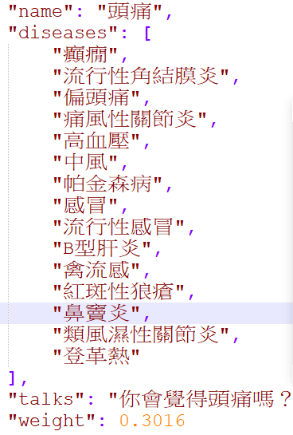
三、Dialogue Manager
Diagnostic Reasoning- TF-IDF
症狀權重:
症狀所含之疾病總共53項
如:頭痛所含之疾病有15種。
故Ans=log(53/16)=0.5481
以最大log(53/1)=1.7242為最大值1，
則頭痛權重為Ans/1.7242=0.3179

Slide 48
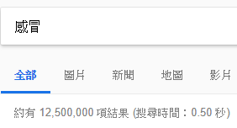
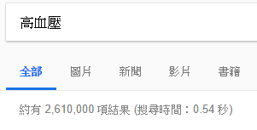
三、Dialogue Manager
Diagnostic Reasoning- TF-IDF
疾病權重:越容易出現之疾病，則權重越大。類似TF

Slide 49
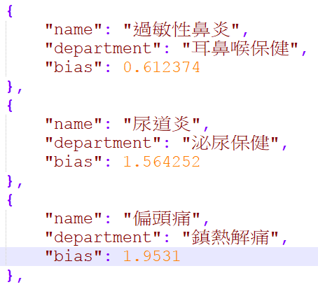
三、Dialogue Manager
Diagnostic Reasoning- TF-IDF
疾病權重:越容易出現之疾病，則權重越大。類似TF

Slide 50
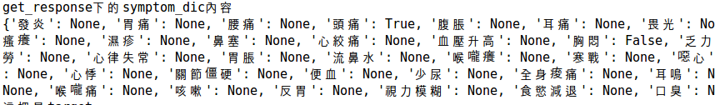
三、Dialogue Manager
Diagnostic Reasoning
有症狀之權重及疾病之權重即可算出疾病之分數
疾病之分數=疾病之權重+此次所得到之症狀權重加總，

Slide 51
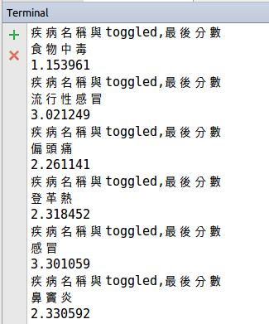
三、Dialogue Manager
Diagnostic Reasoning
疾病之分數=疾病之權重+此次所得到之症狀權重加總，

Slide 52
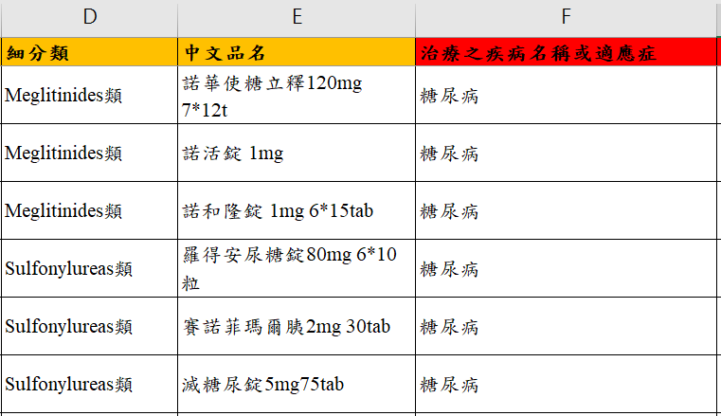
三、Dialogue Manager
Recommended Product
與藥品資料庫連結，找出適合疾病之藥品回饋
從疾病去Excel搜尋，並找出符合之商品(使用http://www.python-excel.org/)
以糖尿病為例，從第F欄搜尋糖尿病，並回傳該列E欄之品名

Slide 53
四、NLG
Template Select
依據DM所傳之資料，決定要使用何種句子當作模板，如果為Requst則選擇問使用者病症之句子模板
使用模板之好處為新增句子方便，且填充不同之資訊則會成為不同句子

Slide 54
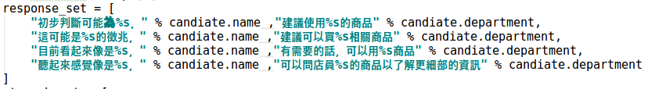
四、NLG
Blank Filling
將模板內之空格處，以前面蒐集到的資訊填充
Response Generation
將前面等句子回傳給使用者

Slide 55
Conclusion
RNN based Slot-Filling 之對話系統
需要大量之已標記之對話資料
不用人工去設許多的rules
Word-Embedding based Slot-Filling之對話系統
不需要大量之已標記之對話資料
需要人工去設許多的rules
缺乏資料庫之系統，可以先從第二種系統先下手，創建系統後再由系統去蒐集對話之資料庫，再使用RNN來做看看

Slide 56
Thanks for your attention

